Slide 1
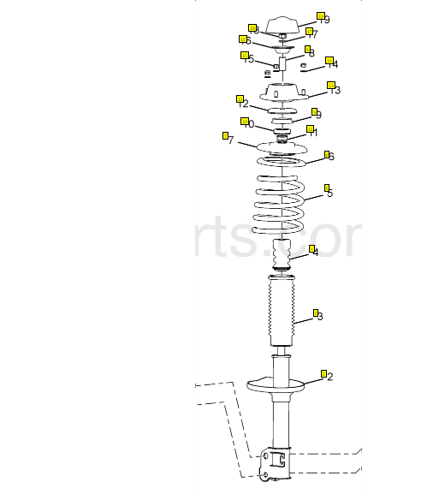
Strut Mounts
Why are we differ from local markets
Superior Rubber compound is used for Better Compression set for longer life in the strut mount but Local Brands use Inferior rubber compounds with lot of fillers which give lesser life in the vehicle.
OE Type metal thickness for longer life whereas local brands which use thinner metal thickness to save on cost. With OE type thickness the strut mounts get better stiffness for better comfort.
To prevent form cracked we are using Anti ozone wax AND Anti oxidant chemicals as OEM used but in local market having an issue of rubber cracked.
OE type projection welding in the metal for better metal strength and less change of metal breakage.
Our Bonding strength of metal to rubber is better than Local Brand

Slide 2
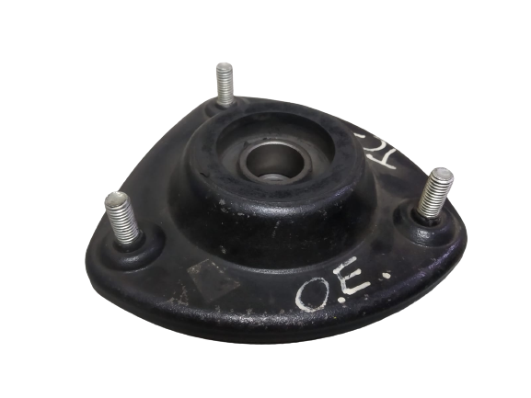
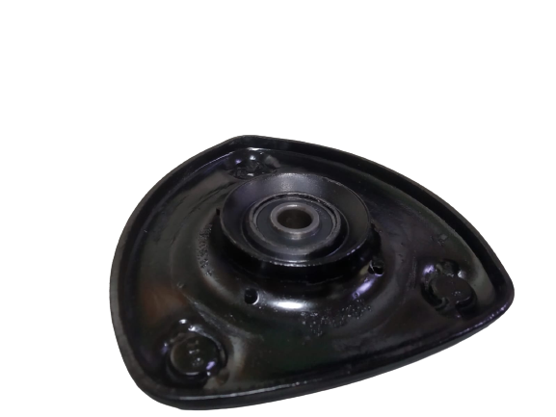
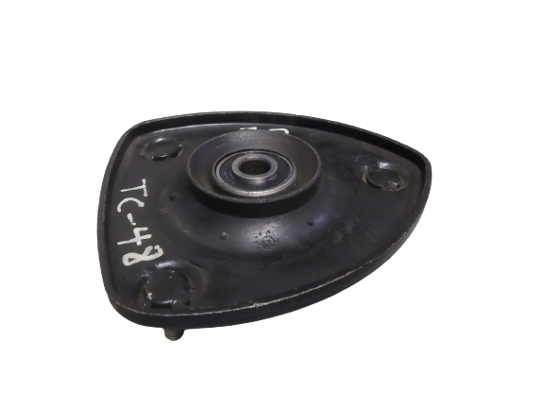
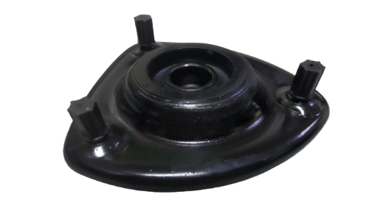
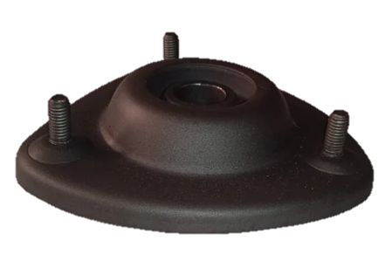
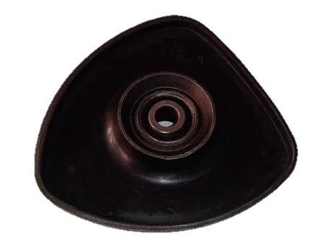
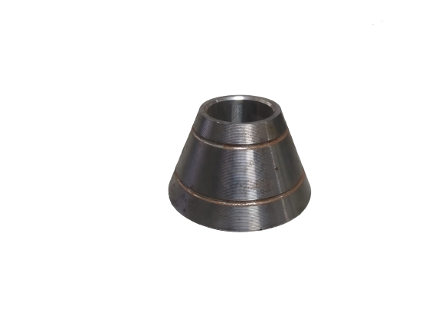
Strut Mounts
Why are we better from other Domestic Brands
FRONT STRUT MOUNT TATA IRIS
OEM
SCHAEFFLER
LOCAL MARKET
Fig. 1
Fig. 1.1
Fig. 2.0
Fig. 2.1
Fig. 3.0
Fig. 3.1
Fig. 2.2
PART WEIGHT :- 604 gm.
PART WEIGHT :- 665 gm.
PART WEIGHT :- 560 gm.
Our part weight is just similar to OEM Part whereas Local brand has less weight due to metal thickness, we are using 3mm metal thickness(fig. 2.0) and local brand is using 2.0mm metal thickness (fig. 3.0) .
Our metal part is develop on CNC machine(fig.2.2) that is why our parts is accurate and precise whereas Local brand metal is develop by forging process.
We are using Nylon cap(fig. 2.1) for thread safety of Bolts whereas local brand doses not use.
Our Bearing is tempered and torque tested whereas Local Brands are without tempering.

Slide 3
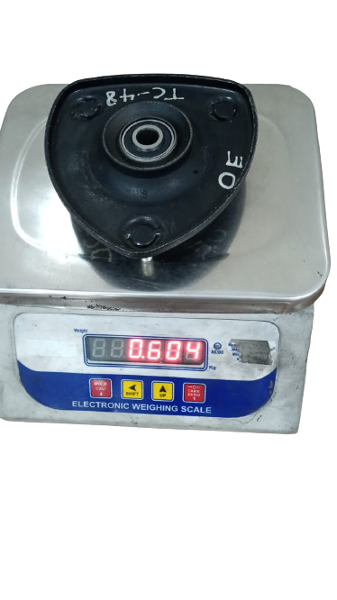
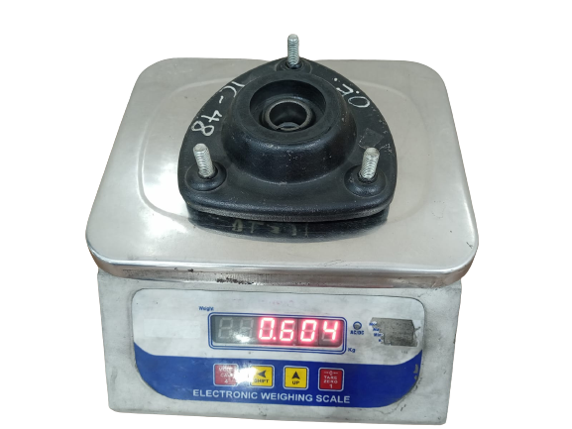
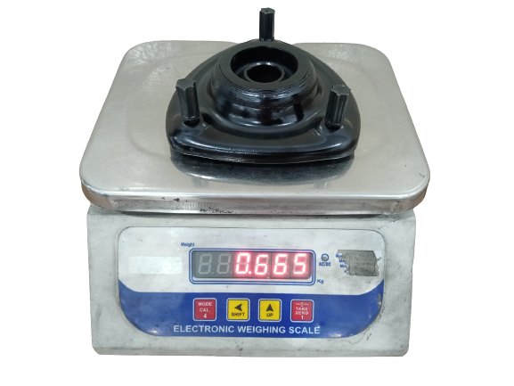
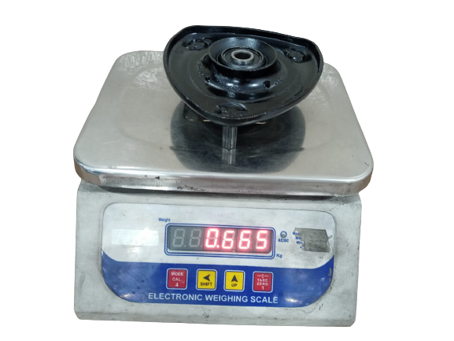
Strut Mounts
Part Weight comparison OE vs OURS
OEM
SCHAEFFLER
Fig. 4.0
Fig. 5.0

Slide 4
Strut Mounts
Why are we better from other Domestic BrandS
Comparison between OEM, SCHAEFFLER and OTHER BRANDS
Characterstics | OEM | SCHAEFFLER | OTHER BRANDS
Rubber grade | Natural Rubber Grade 1 | Natural Rubber Grade 1X | Uses Grade 5
Layout | - | As Per OEM part | Not matching with OEM
Ash content | Less than 6 % | Less than 6 % | More than 15 %
Tensile Strength and Elongation % | More than 125 kg/cm² and 300% | More than 130 kg/cm² and 325% | less than 100 kg/cm² and 225%
Compression set | Less than 28% | Less than 28% | More than 40%
OZONE test | No crack found | No crack found | Not passed in Ozone test Result
Shelf Life | 5 Years | 5 years | 2 years
Durability(cycle) | 35000-40000 km | 35000-40000 km | 10000 km

Slide 5
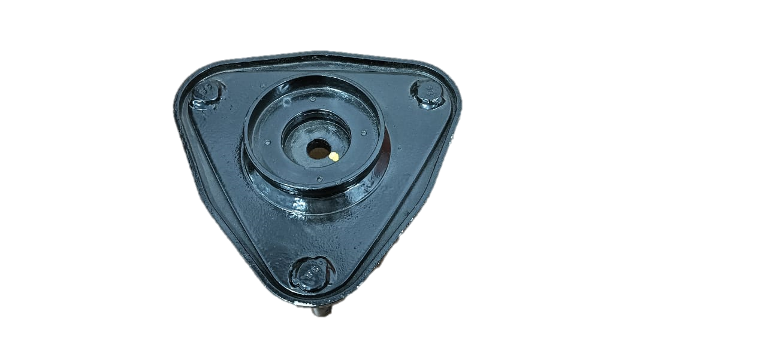
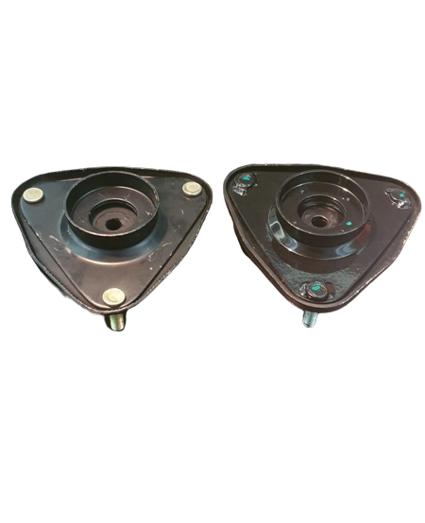
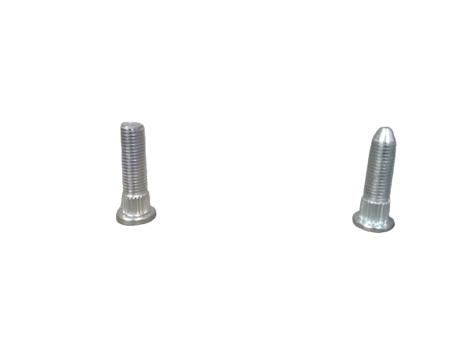
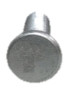
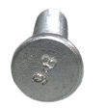
Strut Mounts
Why are we differ from local markets
Front Strut Mount XUV 500
OTHER BRANDS
SCHAEFFLER
Use knurling tempered 9.8/10.9 Bolt which are welded and press fitted
MS Bolt are press fitted only
Spot Welding have less metal strength and durable
Metal Thickness 2 mm
Projection Welding have 4x more strength and reliable
Metal Thickness 3.5 mm
Top plate Spray painted
Top plate powder coated similar to OE Part

