Slide 1
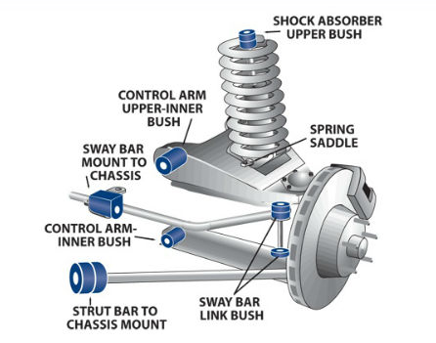
Suspension Bush Kit
Why are we differ from local markets
Superior Rubber compound is used for better life of the bushes but Local Brands use Inferior rubber compounds with lot of fillers which give lesser life in the vehicle.
We use thicker outer /inner tubes for longer life/ stability of the bushes. The thicker outer tubes gives a better pull out load in the vehicle whereas the Local brands using thinner tubes to save on cost.
Our most of Inner tubes are forged/CNC machined for precise fitment in the vehicle and the Local brand is develop the inner tube from second grade material.
To prevent form cracked we are using Anti ozone wax AND Anti oxidant chemicals as OEM used but in local market having an issue of rubber cracked.
All control Arm Bushes are made on imported Injection Molding Machines for better bond strength, complete rubber filling, better tensile strength.

Slide 2
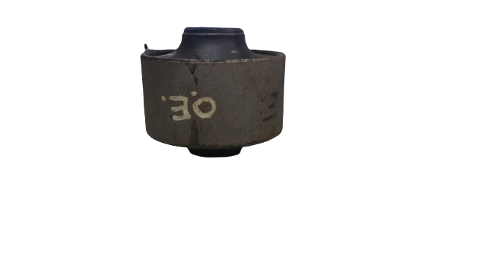
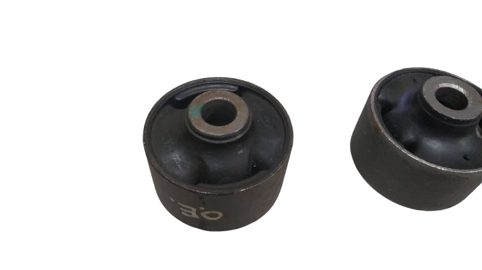
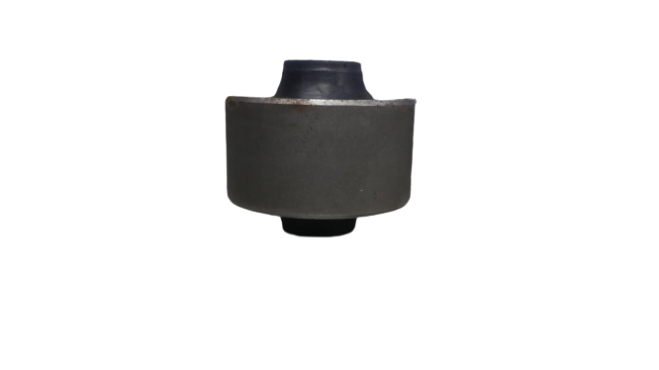
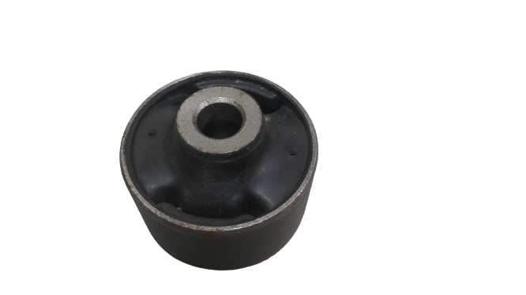
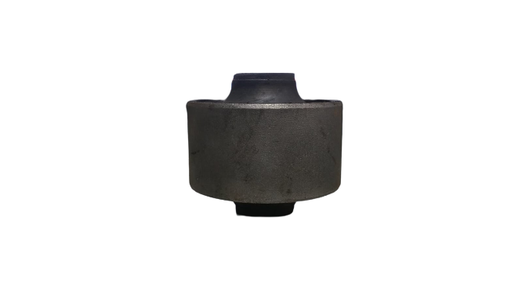
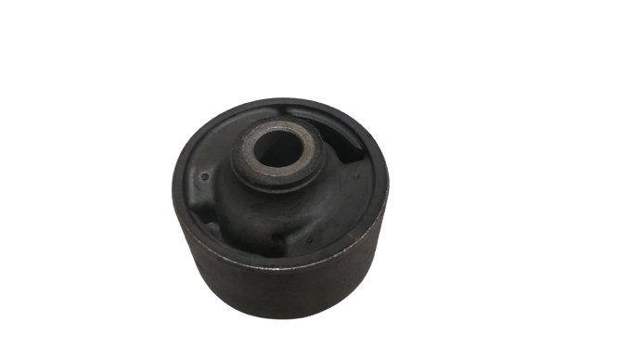
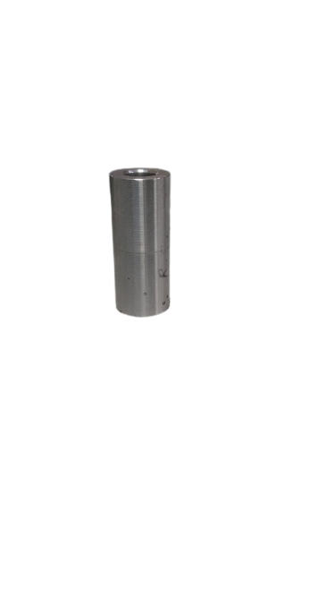
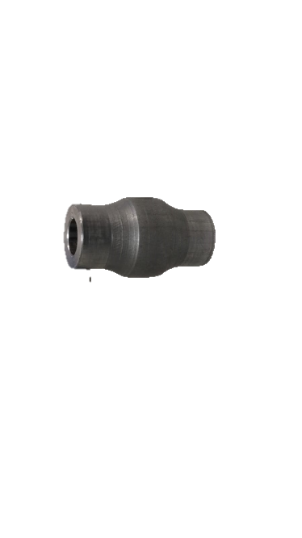
Suspension Bush Kit
Why are we differ from local markets
LOWER ARM BUSH HYUNDAI i20/XCENT
OEM
SCHAEFFLER
OTHER BRANDS
Fig. 1.0
Fig. 1.1
Fig. 2.0
Fig. 2.1
Fig. 3.0
Fig. 3.1
Fig. 2.2
Fig. 3.2
PART WEIGHT :- 436 gm.
PART WEIGHT :- 416 gm.
PART WEIGHT :- 319 gm.
Our part weight is just similar to OEM Part whereas Local brand has less weight due to metal thickness, we are using 5.6 mm Inner tube thickness(fig. 2.2)and outer 3mm thickness and local brand is using 3.0mm inner tube thickness (fig. 3.2) and outer 2mm thickness .
Our most of Inner tubes are forged/CNC machined(fig. 2.2) for precise fitment in the vehicle and the Local brand is develop the inner tube from second grade material(fig. 3.2).
3. Our all control arm bushes are bond tested to minimize the bond fail in the vehicle.
4. For more better clarification please go on next slide.

Slide 3
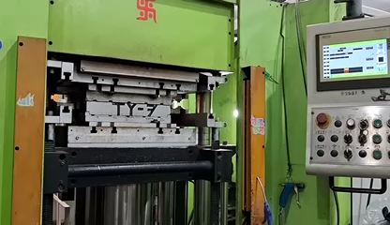
Suspension Bush Kit
Bushes are Made on Latest Technology INJECTION molding Machines

Slide 4
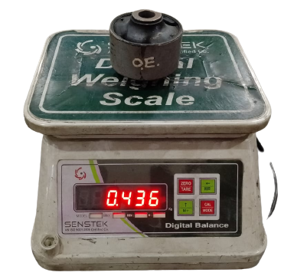
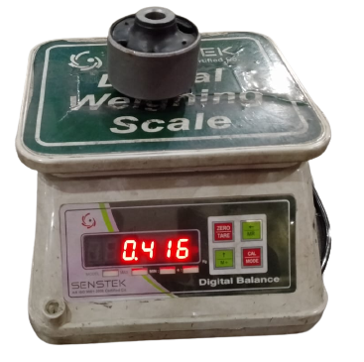
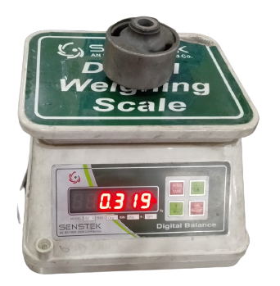
Suspension Bush Kit
Why are we differ from local markets
OEM
SCHAEFFLER
OTHER BRANDS
Fig. 4.0
Fig. 5.0
Fig. 6.0

Slide 5
Suspension Bush Kit
Why are we differ from local markets
Comparison between OEM, SCHAEFFLER and OTHER BRANDS
Characteristics | OEM | SCHAEFFLER | OTHER BRANDS
Rubber grade | Natural Rubber Grade 1 | Natural Rubber Grade 1X | Uses Grade 5
Layout | - | As Per OEM part | Not matching with OEM
Ash content | Less than 6 % | Less than 6 % | More than 15 %
Tensile Strength and Elongation % | More than 125 kg/cm² and 300% | More than 130 kg/cm² and 325% | less than 100 kg/cm² and 225%
Compression set | Less than 28% | Less than 28% | More than 40%
OZONE test | No crack found | No crack found | Not passed in Ozone test Result
Shelf Life | 5 Years | 5 years | 2 years
Durability(cycle) | 35000-40000 km | 35000-40000 km | 10000 km

Slide 6
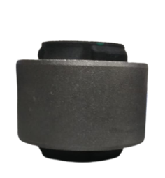
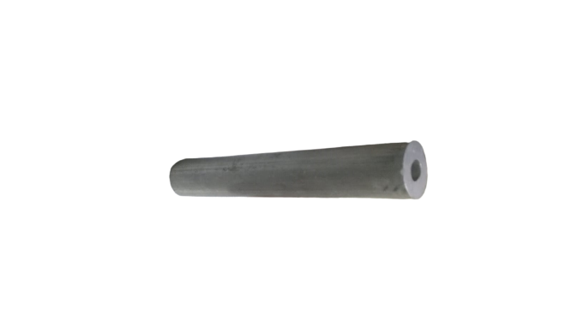
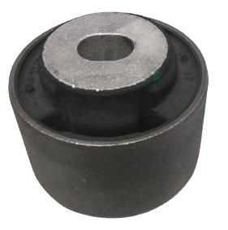
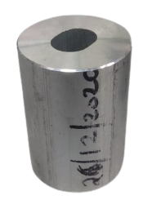
Suspension Bush Kit
Front Lower arm Bush FORD ECOSPORT
We are using prime Alumimium Extruded tubes in the Bushes as per OE whereas Other brands use gravity casting insert.

